Slide 1
Learning the FOSS4g Stack: Python for Geospatial

Slide 2
What we’ll cover
Part 1: Loading Software and Data
Part 2: Overview of Python
Part 3: python packages
Part 4: geospatial additions to python

Slide 3
Course Goals
At the end of this course, you will:
Understand what Python is.
Learn how to use Python to write scripts for automating geographic data.
Learn how to use Python packages to add additional functionality to your Python code.

Slide 4
Part I: Loading our software and data

Slide 5
Part II: An overview of Python

Slide 6
Using Python for Geospatial
Basic Python
Spatial and database tools
QGIS
Arcpy
Special Python packages for geospatial
Postgres/PostGIS
Microsoft Excel
Geocoding

Slide 7
What is Python
Python is an interpreted, interactive, object-oriented programming language. It incorporates modules, exceptions, dynamic typing, very high level dynamic data types, and classes. Python combines remarkable power with very clear syntax. It has interfaces to many system calls and libraries, as well as to various window systems, and is extensible in C or C++. It is also usable as an extension language for applications that need a programmable interface. Finally, Python is portable: it runs on many Unix variants, on the Mac, and on Windows 2000 and later. – www.python.org
A Tour of Python
How to find what you want
How do I run a for loop?
How do I read from a file?

Slide 8
The many flavors of Python
Versions
2.6, 2.7, 2.8
3.0, 3.3, 3.6
Interpreters
IDLE
WinPy
Geany
The Locations – and why it is important!
Python directories
Arcpy directory

Slide 9
The Python Language

Slide 10
The Python Language
Python as a calculator
Variables
Structures
Statements
Expressions
Methods and Functions

Slide 11
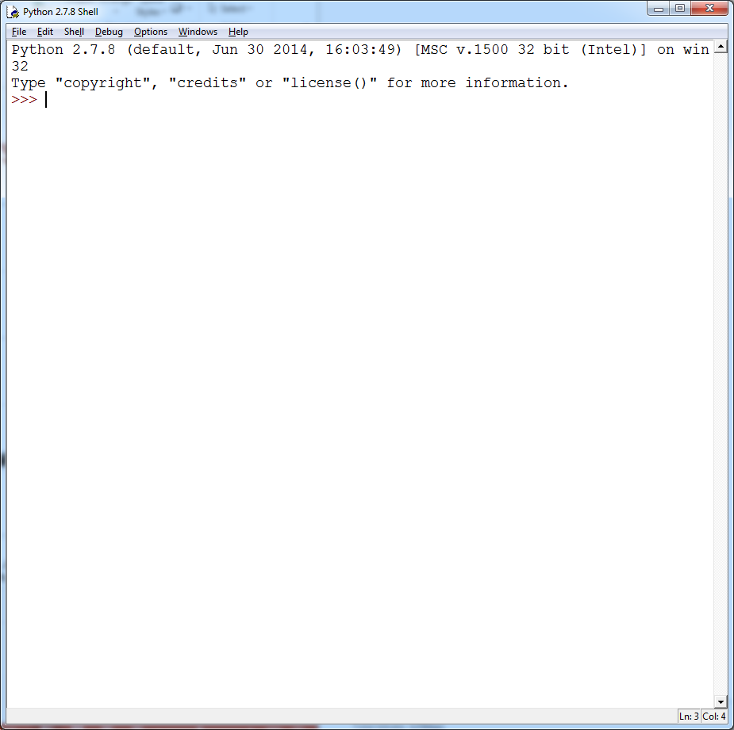
Starting with IDLE
Working with the shell
Working with files

Slide 12
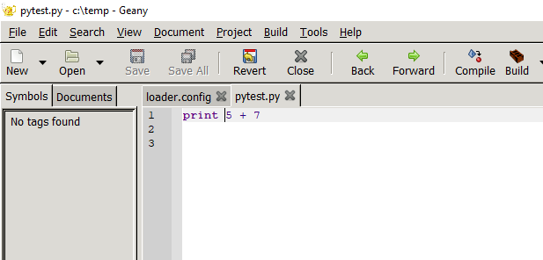
Python as a calculator
Just enter some numbers

Slide 13
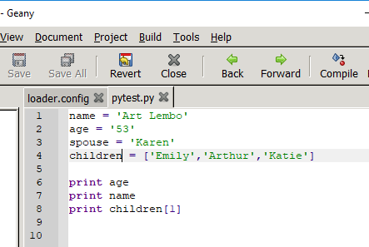
Variables and Data Types
A variable is a name for a value. The computer stores the value in memory. Depending upon what the variable type is, certain operations can be done with the variable.
Some variable types include:
Strings
Numbers
Integer
Floating Point
Lists
name = 'Art Lembo'
age = '54'
children = ['Emily','Arthur','Katie']
print age
print name
print children[1]

Slide 14
Variables and methods
String
len, split, find
replace,left/right([:],[-:])
Number
floor,round, / vs. // vs. float, round
List
append, len, max, min, sort
Notes:
str.replace("my name is art","art", "bob")
len("art Lembo")
str.find("art Lembo","mb")
str.replace(myname,"Art","Arthur")
"art lembo"[2:6]
"art lembo"[-4:]
art lembo"[-4:-2]
"Arthur J Lembo Jr".split(" ")
"Arthur J Lembo Jr".split(" ")[1]
myaddr = "16 Bush Lane Ithaca NY"
addrlist = myaddr.split(" ")
>>> myaddr = "16 Bush Lane Ithaca NY"
>>> addrlist = myaddr.split(" ")
>>> addr = addrlist[0]
>>> stname = addrlist[1]
>>> sttype = addrlist[2]
>>> strcity = addrlist[3]
>>> strstate = addrlist[4]
## list methods
>>> year = [2015,2014,2016]
>>> year.append(2017)
>>> young = max(year)
>>> old = min(year)
>>> count = len(year)
>>> sorted(year, key=int) ##asc
>>> sorted(year, key=int, reverse=True) ##dsc

Slide 15
Lists
Python supports arrays in the form of lists. These include a basic list:
mylist = ["art","bob","sue"]
mylist[0]
or, lists within lists:
mylist = [["art",52],["bob",19],["Sue",44]]
mylist[0]
mylist[0][0]
And, we can do things with lists:
sort, remove, append….

Slide 16
List
a = [66.25, 333, 333, 1, 1234.5]
a[1]
print a.reverse
a.insert(2,1.00)
a.remove(1.0)
a.pop(2)
sortlist = a; sortlist.sort(); sortlist

Slide 17
Dictionaries
A dictionary is a collection which is unordered, changeable and indexed. In Python dictionaries are written with curly brackets, and they have keys and values.
Dict = {'Name': 'Art', 'Age': 54, 'Area': 69 * 44}
print dict['Name']

Slide 18
states = {
'Oregon': 'OR',
'Florida': 'FL',
'California': 'CA',
'New York': 'NY',
'Michigan': 'MI'
}
cities = {
'CA': 'San Francisco',
'MI': 'Detroit',
'FL': 'Jacksonville'
}
cities['NY'] = 'New York'
cities['OR'] = 'Portland‘
print "NY State has: ", cities['NY']

Slide 19
Methods and Functions
f = open('c:/training/python/addresses.txt')
for line in f:
print line
Files
Read a file
Write a file
f = open('c:/training/python/addresses.txt')
o = open('c:/training/python/addout.txt','w')
for line in f:
o.write(line)
o.close()

Slide 20
Quiz
Read the file ‘benchmarks.csv’
Write the file out to ‘benchmarksnew.csv’
Notes:
f = open('c:/tugis/python/benchmarks.csv')
o = open('c:/tugis/python/benchmarksnew.csv','w')
for line in f:
o.write(line)
o.close()

Slide 21
Quiz
How many letters are in supercalifragilisticexpialidocious?
What is the 9th letter in the word?
Use split to create a list of the Beatles: ‘John’,’George’,’Paul’,’Ringo’
Create two variables:
Firstname = ‘John’
Lastname = ‘Lennon’
Append the two names into a new variable called FullName
Notes:
word = 'supercalifragilisticexpialidocious‘; len(word)
word[9]
beatles = 'John George Paul Ringo'
>>> members = beatles.split(" ")
>>> firstname = 'John'
>>> lastname = 'Lennon‘
>>> fullname = []
>>> firstname = ‘John'
>>> lastname = ‘Lennon'
>>> fullname.append(fname)
>>> fullname.append(lname)

Slide 22
Python as a module
Add code
Save
Run the module
Quiz
Instead of the sum, calculate the sum of the squares (use the pow function)
Print out the sum of the squares and the average sum of the squares
array = [12, 9, 17, 16]
sumtotal = 0
for i in array:
sumtotal = i + sumtotal
print sumtotal
print sum(array)
Notes:
array = [12, 9, 17, 16]
sumtotal = 0
for i in array:
sumtotal = pow(i,2)+ sumtotal
print sumtotal
print sum(array)
print sumtotal/len(array)

Slide 23
Program Design
Code Writing
Testing
Error Correction
Logic Correction
Notes:
The program design chart for designing anything in Python be it a function, plugin, component or script.

Slide 24
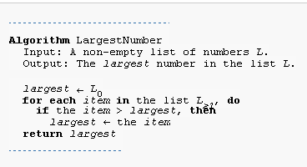
Algorithm - a finite list of well-defined instructions for accomplishing some task
Algorithms are essential to the way computers process information
Algorithms must be rigorously defined:
specified in the way it applies in all possible circumstances that could arise.
conditional steps must be systematically dealt with, case-by-case;
the criteria for each case must be clear (and computable).
array = [2,4,6,3]
largest=0
for i in array:
if i>largest:
largest=i
print largest
Have variable for
largest
Look up in Help:
- list
for loop
if..then..else
Notes:
array = [2,4,6,3]
largest=0
for i in array:
if i>largest:
largest=i
print largest

Slide 25
Statements and Control
if
while
for
Notes:
f = open('c:/training/python/addresses.csv')
for line in f:
addr = line.split(',')
if addr[3] == ' NY':
print(addr[3])
f = open('c:/training/python/addresses.csv')
for line in f:
addr = line.split(',')
if addr[3].strip() == 'NY':
print(addr[3])
f = open('c:/training/python/addresses.csv')
iter_f = iter(f)
next(iter_f)
for line in iter_f:
addr = line.split(',')
if addr[3].strip() == 'NY':
print('New York :' + addr[3])
elif addr[3].strip() == 'NJ':
print('New Jersey :' + addr[3])
else:
print("different state")

Slide 26


Quiz - Temperature program
Now use the input statement
Notes:
Fahrenheit = int(raw_input("Enter a temperature in Fahrenheit: "))
Celsius = (Fahrenheit - 32) * 5.0/9.0
print Celsius
Celsius = int(raw_input("Enter a temperature in Celsius: "))
Fahrenheit =(Celsius * 9.0/5.0) + 32
Print Fahrenheit

Slide 27
Python modules (packages)
A module is a file containing Python definitions and statements.
import math
math.cos(34)
There are many, many “standard” modules built in Python by default
There are many, many, many, MANY other packages you can install

Slide 28
Default modules
Modules for Python 2.7
time
math
HTMLParser
urllib
sqlite3
Notes:
import time, math
start = time.time()
fact = math.factorial ((3*3))
print fact
print math.pi
end = time.time()
print(end - start)
from HTMLParser import HTMLParser as html
hdoc = '<html> <head> TuGIS </head> <body> How to parse </body> </html>'
class MyHTMLParser(html):
def __init__(self):
self.reset()
self.HTMLDATA = []
def handle_data(self, data):
self.HTMLDATA.append(data)
parser = MyHTMLParser()
parser.feed(hdoc)
new = parser.HTMLDATA
print new

Slide 29
SQLite Example (not spatial, yet)
import sqlite3
conn = sqlite3.Connection('c:/training/python/tompkins.sqlite')
answer = conn.execute('SELECT * FROM parcels LIMIT 3')
for row in answer:
print row
Quiz
Find the average ASMT value for each Propclass in parcels
Notes:
import sqlite3
conn = sqlite3.Connection('c:/training/python/tompkins.sqlite')
answer = conn.execute('SELECT * FROM parcels LIMIT 3')
for row in answer:
print(row)
import sqlite3
conn = sqlite3.Connection('c:/training/python/tompkins.sqlite')
answer = conn.execute('SELECT AVG(asmt), propclass FROM parcels GROUP BY propclass')
for row in answer:
print( "Property Class ",row[1], " ", row[0])

Slide 30
import os
os.chdir("c:/program files/qgis 3.8/bin")
import sqlite3
##pkey = input('enter your parcel key: ')
conn = sqlite3.Connection('c:/training/python/tompkins.sqlite')
conn.enable_load_extension(True)
conn.execute('SELECT load_extension("mod_spatialite")')
answer = conn.execute('''SELECT sum(asmt) AS sumasmt, propclass
FROM parcels, floodzones
WHERE ST_Intersects(parcels.geometry,floodzones.geom)
GROUP BY propclass ORDER BY sumasmt''')
for row in answer:
print( "Property Class ",row[1], " $", row[0])

Slide 31
import os
os.chdir("c:/program files/qgis 3.8/bin")
import sqlite3
pkey = input('enter your parcel key: ')
conn = sqlite3.Connection('c:/training/python/tompkins.sqlite')
conn.enable_load_extension(True)
conn.execute('SELECT load_extension("c:/program files/QGIS 3.8/bin/mod_spatialite")')
answer = conn.execute('''SELECT min(st_distance(parcels.geometry,floodzones.geom)) as dist
FROM parcels, floodzones
WHERE parcels.parcelkey = ''' + '\'' + pkey + '\'')
for row in answer:
if row[0] == 0.0:
print('parcel intersects the floodzone')
else:
print(row[0])

Slide 32
pip – the magic of Python
Run pip to install third party modules:
pip install numpy
pip install googlemaps
pip install pygal
pip install geocoder
pip is a package management system used to install and manage software packages written in Python. Many packages can be found in the Python Package Index (PyPI). Python 2.7.9 and later (on the python2 series), and Python 3.4 and later include pip (pip3 for Python 3) by default.

Slide 33
Creating an external function for linear algebra
Pycall.py
from pyclass import ols_function, numpy
A = numpy.array([[1,2,3],[4,5,6],[7,8,9]])
L = numpy.array([[3],[2],[1]])
myresult = ols_function(A,L)
print(myresult)
Ols.py
import numpy
def ols_function(A,L):
AT = numpy.transpose(A)
ATA = numpy.matmul(AT,A)
ATAi = numpy.linalg.inv(ATA)
ATAiAT = numpy.matmul(ATAi,AT)
ols = numpy.matmul(ATAiAT,L)
return ols

Slide 34
PostGIS
import psycopg2
conn = psycopg2.connect(dbname = 'tompkins',host='127.0.0.1',user='postgres',password='postgres', port=5433)
cur = conn.cursor()
thesql = ('''SELECT tcparcel.parcelkey, zone
FROM floodzones, tcparcel
WHERE ST_Intersects(tcparcel.geom,floodzones.geom)''')
cur.execute(thesql)
theresult = cur.fetchall()
for j in theresult:
print ('Park ' + j[0] + 'Intersects parcel ' + j[1])
import psycopg2
conn = psycopg2.connect(dbname = 'tompkins',host='127.0.0.1',user='postgres',password='postgres', port=5433)
cur = conn.cursor()
thesql = input('enter sql: ')
print (thesql)
cur.execute(thesql)
theresult = cur.fetchall()
for j in theresult:
print(j)

Slide 35
Microsoft Excel

Slide 36
Quick and dirty Excel
pip install pypiwin32
import win32com.client
excel = win32com.client.Dispatch("Excel.Application")
mylist = [10,20,30,40,50,60,70,80,90]
myAvg= excel.WorksheetFunction.Average([mylist])
print(myAvg)

Slide 37
Advanced Excel
import psycopg2, win32com.client, numpy as np
conn = psycopg2.connect(dbname = 'tompkins',host='127.0.0.1',user='postgres',password='postgres', port='5433')
excel = win32com.client.Dispatch("Excel.Application")
cur = conn.cursor()
thesql = ('SELECT asmt FROM tcparcel')
cur.execute(thesql)
theresult = cur.fetchall()
# Here we will issue an Excel function to determine the standard deviation from the
# selected values
thestdev = excel.WorksheetFunction.StDev(theresult)
print ('The Standard Deviation is: ' + str(thestdev))
# Now we will add the confidence interval, as calculated by Excel
conf = excel.WorksheetFunction.Confidence(.45,thestdev,len(theresult))
print ('Average: ' + str(np.average(theresult)) + ' Confidence Interval: ' + str(conf))
print(' ')
print (' ')
print (str(np.average(theresult) - conf) + ' ' + str(np.average(theresult)) + ' ' + str(np.average(theresult) + conf))
conn.close()

Slide 38
Now for the spatial stuff
Geocoding: geocoder, censusgeocoder, Google
Spatial operations: postgis
Spatial database: postgres

Slide 39
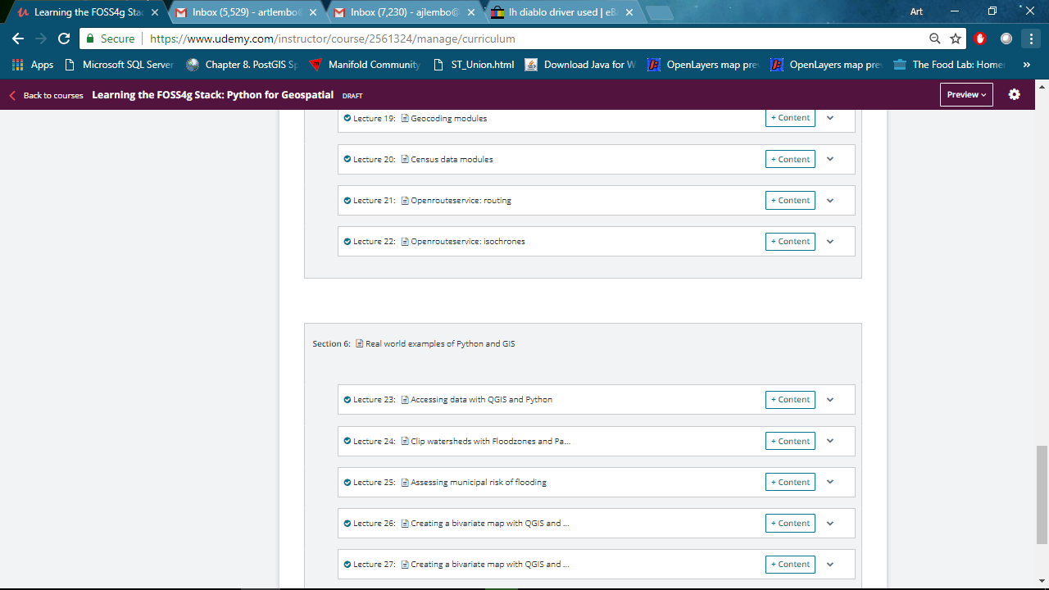

Slide 40
Geocoding
from googleapi import googleapikey
requests.packages.urllib3.disable_warnings()
import geocoder
apikey = googleapikey
f = open('c:/training/python/addresses.csv','r')
googleout = open('c:/temp/googleoutaddress.csv','w')
googleout.write("\"address\",\"lon\",\"lat\",\"matchcode\" \n")
for line in f:
gc = geocoder.google(line,key=apikey)
googleout.write(gc.address.replace(',','') + ' , ' + str(gc.lng) + ',' + str(gc.lat) + ',' + gc.accuracy + '\n')
print (line," has an accuracy of ", gc.accuracy)
googleout.close()
f.close()

Slide 41
Geocoding
import censusgeocode
cg = censusgeocode.CensusGeocode()
census_gc = cg.onelineaddress('16 Bush Lane Ithaca NY')
Print( census_gc)
import censusgeocode
cg = censusgeocode.CensusGeocode()
f = open('c:/training/python/addresses.csv', 'r')
out = open('c:/temp/outaddress1.csv','w')
out.write('addr, longitude, latitude, accuracy '+'\n')
for line in f:
census_gc = cg.onelineaddress(line)
if len(census_gc) > 0:
out.write(str(line) + ',' + str(census_gc[0]['coordinates']['x']) + ',' + str(census_gc[0]['coordinates']['y'])+'\n')

Slide 42
import psycopg2, geocoder
from googleapi import googleapikey
##requests.packages.urllib3.disable_warnings()
conn = psycopg2.connect(dbname = 'tompkins',host='127.0.0.1',user='postgres',password='postgres', port=5433)
cur = conn.cursor()
apikey = googleapikey
f = open('c:/training/python/addresses.csv','r')
thesql = 'DROP TABLE IF EXISTS newpoints'
cur.execute(thesql)
thesql = 'CREATE TABLE newpoints (id SERIAL PRIMARY KEY, address VARCHAR, geom geometry(point,4326))'
print( thesql)
cur.execute(thesql)
for line in f:
gc = geocoder.google(line,key=apikey)
if gc.accuracy == 'ROOFTOP':
thesql = 'INSERT INTO newpoints(address,geom) VALUES (\'' + gc.location + '\',ST_SetSRID(ST_Point(' + str(gc.lng) + ',' + str(gc.lat) + '),4326))'
cur.execute(thesql)
print(thesql)
conn.commit()
f.close()

Slide 43
Excel quiz
Create another list called mylist 2:
[10,8,19,40,50,15,122,33,44]
What is the standard deviation of the list?
Create another list called mylist 2:
[16,22,30,45,58,69,77,88,99]
What is the Pearson correlation coefficient?
Notes:
## 1
# Import arcpy module
import arcpy
# Local variables:
parcels = "E:\\tugis\\python\\crisfield.gdb\\parcels"
flood = "flood"
flood__2_ = flood
flood_parcels = "E:\\tugis\\python\\crisfield.gdb\\flood_parcels"
flood_stat = "E:\\tugis\\python\\crisfield.gdb\\flood_stat"
# Process: Select Layer By Attribute
arcpy.SelectLayerByAttribute_management(flood, "NEW_SELECTION", "gridcode > 6")
# Process: Intersect
arcpy.Intersect_analysis("E:\\tugis\\python\\crisfield.gdb\\parcels #;flood #", flood_parcels, "ALL", "", "INPUT")
# Process: Summary Statistics
arcpy.Statistics_analysis(flood_parcels, flood_stat, "OBJECTID COUNT", "")
## 2
# Import arcpy module
import arcpy
# Local variables:
parcels = "E:\\tugis\\python\\crisfield.gdb\\parcels"
flood = "E:\\tugis\\python\\crisfield.gdb\\flood"
flood__2_ = flood
flood_parcels = "E:\\tugis\\python\\crisfield.gdb\\flood_parcels"
flood_stat = "E:\\tugis\\python\\crisfield.gdb\\flood_stat"
# Process: Select Layer By Attribute
arcpy.SelectLayerByAttribute_management(flood, "NEW_SELECTION", "gridcode > 6")
# Process: Intersect
arcpy.Intersect_analysis("E:\\tugis\\python\\crisfield.gdb\\parcels #;flood #", flood_parcels, "ALL", "", "INPUT")
# Process: Summary Statistics
arcpy.Statistics_analysis(flood_parcels, flood_stat, "nfmttlvl SUM", "")

Slide 44
Arcpy Examples

Slide 45
Working with Arcpy in ArcGIS
Fire up ArcMap
Click Python window
Start typing code
Look up help files – they are excellent!

Slide 46
Things you do most of the time…
Load layers
Select layers by attributes
Select layers by some spatial operation
Perform some kind of spatial analysis

Slide 47
Buffer watershed and clip parcels
import arcpy
arcpy.env.overwriteOutput = True
arcpy.env.workspace = "c:/training/python/tompkins.gdb"
wstemp = arcpy.MakeFeatureLayer_management("watersheds","wsclip","watershed = 'Cascadilla Creek'")
##testvar = input("How far do you want the buffer in meters")
testvar = 500
wsbuffer = arcpy.Buffer_analysis(wstemp,"wsbuffer",testvar)
wsclip = arcpy.Clip_analysis("parcels","wsbuffer","parclip")
arcpy.Delete_management(wsbuffer)
arcpy.Delete_management(wsclip)

Slide 48
Total value of land in the AE floodzone by land use
import arcpy
import numpy
arcpy.env.workspace = "c:/training/python/tompkins.gdb"
parceltemp = arcpy.MakeFeatureLayer_management("parcels")
floodtemp = arcpy.MakeFeatureLayer_management("floodzones","zone = 'AE'")
LUs = [row[0] for row in arcpy.da.SearchCursor(parceltemp,"propclass")]
LUs = list(set(LUs))
for lu in LUs:
parsel = arcpy.SelectLayerByLocation_management(parceltemp,"INTERSECT",floodtemp)
parsubsel = [row[0] for row in arcpy.da.FeatureClassToNumPyArray(parsel,"asmt", "propclass = '" + lu + "'")]
totalvalue = numpy.sum(parsubsel)
avgvalue = numpy.average(parsubsel)
stdvalue = numpy.std(parsubsel)
print "total value of " + lu + "= " + str(totalvalue) #+ " and the CV is " + str(stdvalue / avgvalue)

Slide 49
QGIS Examples

Slide 50
Working with Qpy in QGIS
Fire up QGIS
Click Python window
Start typing code
Look up help files – not so excellent ☹

Slide 51
Some QGIS documentation
https://docs.qgis.org/testing/en/docs/user_manual/processing/console.html
Let’s try it:
processing.algorithmHelp("native:buffer")
Start typing code

Slide 52
Buffer watershed and clip parcels
import qgis
fz = QgsProject.instance().mapLayersByName('floodzones')[0]
fz.selectByExpression('zone = \'AE\'',QgsVectorLayer.SetSelection)
parcels = QgsProject.instance().mapLayersByName('tcparcel')[0]
##testvar = input("How far do you want the buffer in meters")
testvar = 500
mybuff = processing.run("native:buffer",{'INPUT': fz,'DISTANCE':100, 'OUTPUT':"c:/temp/fzbuff.shp"})
parclip = processing.run("native:clip",{'INPUT': parcels,'OVERLAY':'c:/temp/fzbuff.shp', 'OUTPUT':'c:/temp/parclip.shp'})
cliplayer = QgsVectorLayer('c:/temp/parclip.shp','parclip','ogr')
QgsProject.instance().addMapLayer(cliplayer)

Slide 53
Buffer watershed and clip parcels
import qgis
floodzones = iface.addVectorLayer('c:/training/python/shapefiles/Floodzones.shp', "", "ogr")
floodzones.setName('floodz')
parcels = iface.addVectorLayer('c:/training/python/tompkins.gdb|layername=parcels', "parcels", "ogr")
firestations = iface.addVectorLayer('c:/training/python/shapefiles/FireStations.shp', "firestations", "ogr")
firebuf = processing.runAndLoadResults("native:buffer", {'INPUT':firestations,'DISTANCE':100,'OUTPUT':'memory:'})
firesp = processing.runAndLoadResults('qgis:reprojectlayer',{'INPUT': firestations, 'TARGET_CRS': 'EPSG:32618', 'OUTPUT': 'memory:firereproj'})
firebuf = processing.runAndLoadResults("native:buffer", {'INPUT':'Reprojected','DISTANCE':400,'OUTPUT':'memory:'})
selectedfz = processing.run("native:extractbyexpression", {'INPUT':'floodz', 'EXPRESSION':'ZONE = \'AE\'','OUTPUT':'memory:'})
selectedfz = processing.runAndLoadResults("native:extractbyexpression", {'INPUT':'floodz', 'EXPRESSION':'ZONE = \'AE\'','OUTPUT':'memory:'})
selectedfz.featureCount()
selpar = processing.runAndLoadResults("native:extractbylocation",{'INPUT':'parcels','PREDICATE':[0],'INTERSECT':"Matching features",'OUTPUT':'memory:'})['OUTPUT']

Slide 54
Total value of land in the AE floodzone by land use
import numpy
sp = QgsProject.instance().mapLayersByName('Extracted (location)')[0]
selected_features = sp.selectAll()
features = sp.getFeatures()
myidx = features.fields().indexFromName('asmt')
myarray = []
for i in features:
myarray.append(i[19])
print(numpy.sum(myarray))

Slide 55
Total value of land in the AE floodzone by land use
import qgis, numpy
floodzones = iface.addVectorLayer('c:/training/python/shapefiles/Floodzones.shp', "", "ogr")
floodzones.setName('floodz')
parcels = iface.addVectorLayer('c:/training/python/tompkins.gdb|layername=parcels', "parcels", "ogr")
selectedfz = processing.runAndLoadResults("native:extractbyexpression", {'INPUT':'floodz', 'EXPRESSION':'ZONE = \'AE\'','OUTPUT':'memory:'})
selpar = processing.runAndLoadResults("native:extractbylocation",{'INPUT':'parcels','PREDICATE':[0],'INTERSECT':"Matching features",'OUTPUT':'memory:'})['OUTPUT']
sp = QgsProject.instance().mapLayersByName('Extracted (location)')[0]
selected_features = sp.selectAll()
features = sp.getFeatures()
myidx = parcels.fields().indexFromName('asmt')
myarray = []
for i in features:
myarray.append(i[myidx])
print(numpy.sum(myarray))

Slide 56
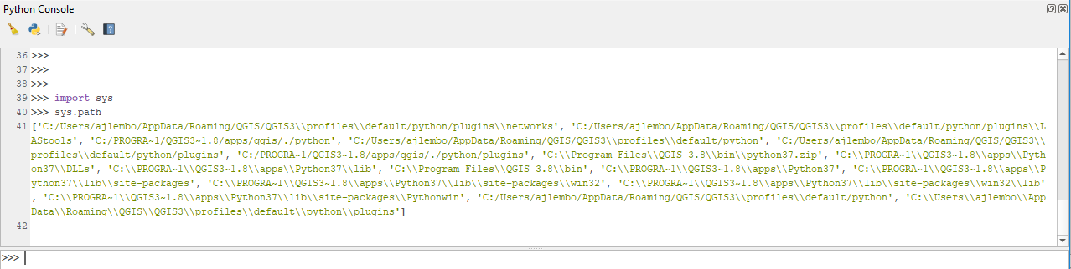
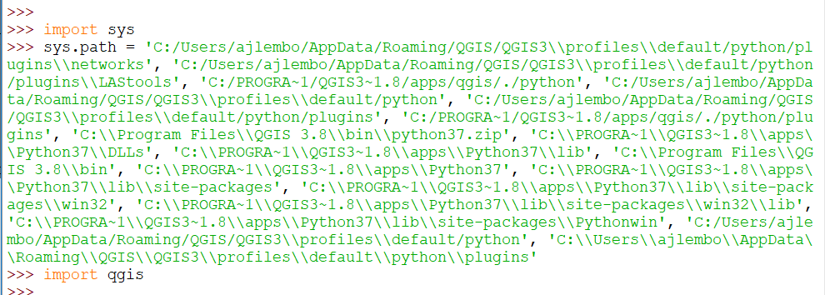

Slide 57
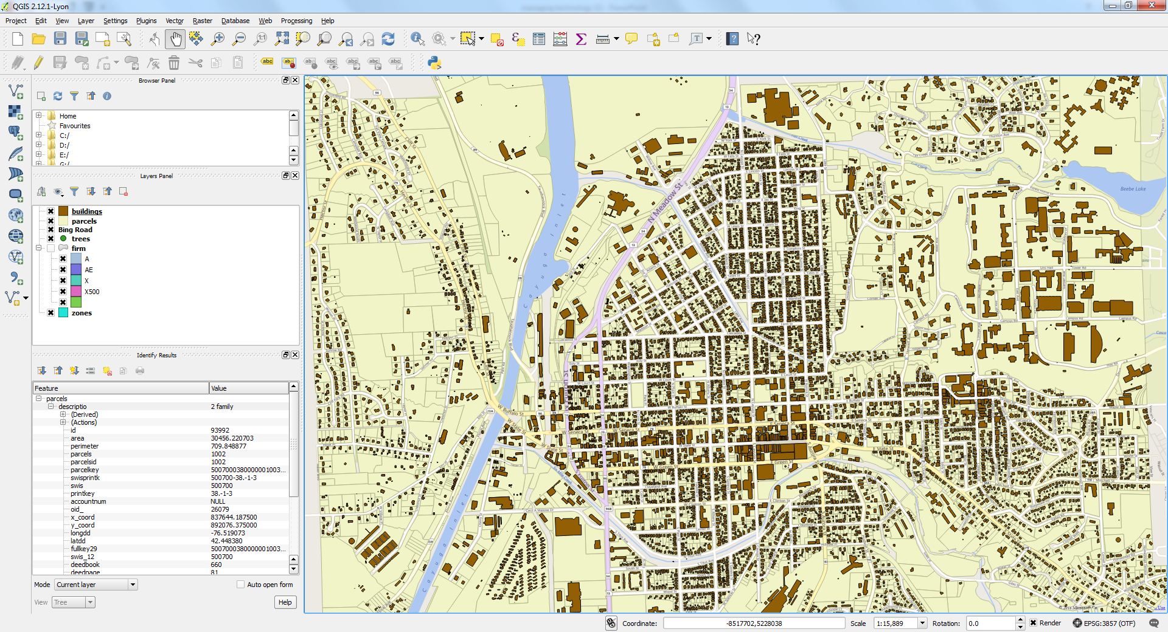
Municipal Risk
Exploration of vector functions in Arcpy
For this exercise, you will explore the use of vector analysis to determine at-risk properties in certain flood zones, and categorize the data. Let’s assume our stakeholders are interested in:
The total value of all land within the ‘AE’ flood zone.
The total value of residential properties in the ‘AE’ flood zone.
The amount of residential land in the ‘AE’ flood zone.
Notes:
SELECT sum(nfmttlvl)::numeric::money
FROM parcels, firm
WHERE ST_Intersects(parcels.geometry,firm.geometry)
AND firm.zone = 'X'
SELECT sum(nfmttlvl)::numeric::money
FROM parcels, firm
WHERE ST_Intersects(parcels.geometry,firm.geometry)
AND firm.zone = 'X'
AND "LU" = 'R‘
SELECT sum(ST_Area(ST_Intersection(parcels.geometry,firm.geometry)))
FROM parcels, firm
WHERE ST_Intersects(parcels.geometry,firm.geometry)
AND firm.zone = 'X'
AND "LU" = 'R'

Slide 58
Steps – in ArcGIS
import arcpy
myconn = arcpy.CreateDatabaseConnection_management("c:/temp/","tompkins","POSTGRESQL","127.0.0.1,5433","DATABASE_AUTH","postgres","postgres","SAVE_USERNAME","tompkins")
arcpy.SelectLayerByAttribute_management("tompkins.public.floodzones","NEW_SELECTION","zone='AE'")
arcpy.SelectLayerByLocation_management("tompkins.public.tcparcel","INTERSECT","tompkins.public.floodzones",0,"NEW_SELECTION")
arcpy.Statistics_analysis("tompkins.public.tcparcel","statout",[["asmt","SUM"]],"propclass")

Slide 59
Steps – separate script
import arcpy
arcpy.env.overwriteOutput = True
if arcpy.Exists(r'c:\temp\tompkins.sde'):
arcpy.env.workspace = 'c:/temp/tompkins.sde'
myconn = arcpy.env.workspace
else:
myconn = arcpy.CreateDatabaseConnection_management("c:/temp/","tompkins","POSTGRESQL","127.0.0.1,5433","DATABASE_AUTH","postgres","postgres","SAVE_USERNAME","tompkins")
sdeconn = str(myconn)+"\\"
floodfeat = arcpy.MakeFeatureLayer_management(sdeconn+"tompkins.public.floodzones")
parcelfeat = arcpy.MakeFeatureLayer_management(sdeconn+"tompkins.public.tcparcel")
aeflood = arcpy.SelectLayerByAttribute_management(floodfeat,"NEW_SELECTION","zone='AE'")
parflood = arcpy.SelectLayerByLocation_management(parcelfeat,"INTERSECT",aeflood,0,"NEW_SELECTION")
##arcpy.Statistics_analysis(parflood,"c:/temp/statoutpf/statoutpf",[["asmt","SUM"]],"propclass")
stattable = arcpy.Statistics_analysis(parflood,"c:/temp/statoutpf.dbf",[["asmt","SUM"]],"propclass")
for row in arcpy.SearchCursor(stattable):
print row.propclass + " $" + str(row.SUM_asmt)

Slide 60
The total value of Residential properties within the ‘X’ flood zone.
import arcpy
arcpy.env.workspace = r'C:\training\python\tompkins.gdb'
arcpy.MakeFeatureLayer_management('parcels', 'parcel_layer')
arcpy.MakeFeatureLayer_management('floodzones', 'firm_layer')
arcpy.SelectLayerByLocation_management('parcel_layer', 'intersect', 'firm_layer')
arcpy.SelectLayerByAttribute_management('parcel_layer','SUBSET_SELECTION', "propclass = 'Residential'")

Slide 61
import googlemaps
gmaps = googlemaps.Client(xxxxxxxxxxxxxxxxxxxxxxxxxxxxxxx')
startAddress = "1440 East Sandy Acres Drive, Salisbury MD"
endAddresses = ["6 Briaroot Drive, Smithtown, NY","7 Hickory Road, Bayville NY", "16 Bush Lane, Ithaca, NY"]
for endAddress in endAddresses:
directions = gmaps.directions(startAddress, endAddress)
print "time to " + endAddress + ": " + directions[0]['legs'][0]['duration']['text']

Slide 62
import arcpy, math
fc = arcpy.GetParameterAsText(0)
fields = arcpy.ListFields(fc, "bivariate")
if len(fields) != 1:
arcpy.AddField_management(fc, "bivariate", "text", 3)
f1 = arcpy.GetParameterAsText(1)
f2 = arcpy.GetParameterAsText(2)
fields = ['bivariate',f1,f2]
var1 = [row[0] for row in arcpy.da.SearchCursor(fc, fields[1])]
var2 = [row[0] for row in arcpy.da.SearchCursor(fc, fields[2])]
bivariate1 = max(var1)
bivariate2 = max(var2)
print str(bivariate1)
with arcpy.da.UpdateCursor(fc,fields) as cursor:
for row in cursor:
first = math.ceil((float(row[1]) / (float(bivariate1) +.001))*3)
second = math.ceil((float(row[2]) / (float(bivariate2) +.001))*3)
row[0] = str(int(first)) + '.' + str(int(second))
cursor.updateRow(row)

